Slide 1
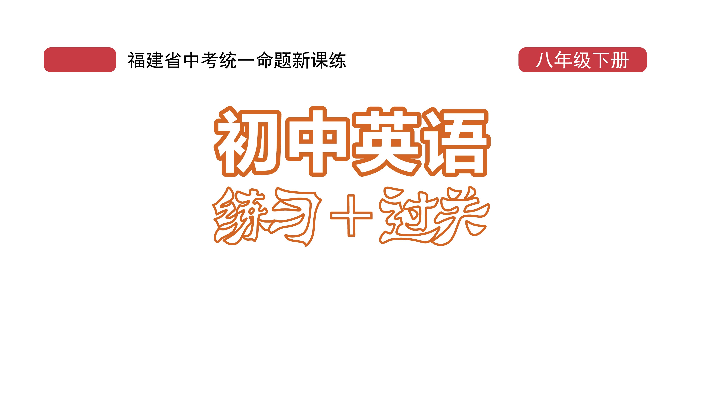
课时练习
模块八 第三章 读写综合训练

Slide 2
一、完形填空。
No one knows what life will be like in the future. But it is 1 to guess.
Tom said, “In 2050, everybody will 2 a very small computer. And it looks like a watch. The computer will give people the 3 to all their questions.
1. A. important B. interesting C. boring
2. A. carry B. bring C. give
3. A. ideas B. news C. answers
B
A
C

Slide 3
一、完形填空。
A
And they will be able to 4 their friends from all over the world through the computer.”
“At that time, all kinds of robots(机器人) will do most of the work and people will have more holidays. Perhaps they will 5 only two or three days a week,” said Jack.
4. A. one B. first C. a
5. A. money B. trouble C. fun
A

Slide 4
一、完形填空。
“In 2050, people can travel to anywhere 6 . They will be able to 7 to the moon by spaceship(宇宙飞船) and spend their holidays there,” Bob said.
“I’m very 8 to hear that. I really hope to fly to the moon. And I also hope I’ll be able to live in the
6. A. carefully B. easily C. slowly
7. A. fly B. run C. walk
8. A. sorry B. afraid C. happy
B
A
C

Slide 5
一、完形填空。
sea,” said Fred. “Then I will feel like a 9 . Won’t that be interesting?”
“In 2050, there will be no traffic jams on the earth, 10 many people will live on Mars(火星),” Tom added.
9. A. bird B. fish C. plant
10. A. so B. but C. because
B
C

Slide 6
二、阅读理解。
Everyone must know the phrase “cyber manhunt”. It refers to(指的是) finding a person’s personal information on the Internet and then letting all the people know it.
Cyber manhunt is a kind of cyber bullying(网络暴力). China is working hard to protect people’s personal information online. On October 1, 2020, China’s first regulation(规定) to protect children online started to work.

Slide 7
二、阅读理解。
According to the regulation, no group or person should produce or talk about information that can harm the safety of anyone under the age of 14. If you find someone doing this, you can call the police.
This is quite important to children. In 2019, the number of minors using the Internet in China was 169 million. About 89.5 percent of primary school students and 99.4 percent of junior high school students were Internet users. A recent report shows that 15.6 percent of minors in China have ever been

Slide 8
二、阅读理解。
hurt by cyber bullying. After someone puts their information on the Internet, other people may say unkind things to them. Some of them have even tried to take their own lives because of cyber bullying. Once children’s information is shown online, their safety is also in danger.
Cyber bullying is bad for children’s health. It’s time to protect their personal information online.

Slide 9
二、阅读理解。
( )1. Why does the writer write Paragraph 3?
A. To show how the new regulation works.
B. To show when the new regulation works.
C. To explain why China made the new regulation.
D. To give an example of how cyber manhunt works.
A

Slide 10
二、阅读理解。
( )2. Why is the regulation so important to children?
A. Because cyber bullying is bad for children’s safety.
B. Because children are very interested in cyber bullying.
C. Because children sometimes don’t know what cyber bullying is.
D. Because parents care about their children.
A

Slide 11
二、阅读理解。
( )3. What does the underlined word “minors” in Paragraph 4 mean in Chinese?
A. 成年人 B. 女人
C. 男人 D. 未成年人
D

Slide 12
二、阅读理解。
( )4. Which paragraph tells the time the new regulation started to work？
A. Paragraph 1. B. Paragraph 2.
C. Paragraph 3. D. Paragraph 4.
B

Slide 13
二、阅读理解。
( )5. In which section of a newspaper can you read the passage?
A. Health and habits.
B. History and culture.
C. Information and safety.
D. People and environment.
C

Slide 14
三、短文填空。
As is known to all, there are 55 minority groups in China, each with its 1 (tradition) customs（风俗） and culture. Now let’s take 2_ look at the Tibetan Minority.
The Tibetan Minority groups live in Qinghai, Gansu, Sichuan and Yunnan Provinces. But Tibet, known as “the Roof of the World”, is their 3___ /meɪn/ living place. As there is rich grass in Tibet, most people live on 4 (raise) sheep, goats,
traditional
a
main
raising

Slide 15
三、短文填空。
cattle and growing a special kind of plant called Qingke. Because of the weather, people there often wear warm and comfortable boots in winter, and they always wear robes(长袍) which are made 5 the fur of sheep. Often they take off one sleeve(袖子) of the clothes in order to work 6 (easy) and use it as a warm quilt(被子) at night.
of
easily

Slide 16
三、短文填空。
Both men and women there are good at singing and dancing. 7 meeting an important guest, they will present him or her a Hada, a piece of long white silk cloth, to show their respect(尊重). And they will also 8 /trit/ the guest to a special kind of drink called Suyou tea.
When
treat

Slide 17
三、短文填空。
The Tibetan people are warmhearted and 9 (friend). Their history and culture are very important in China, so we should protect them and let them 10 /ʃaɪn/ for long.
friendly
shine

Slide 18
四、书面表达。
假如你是李娜， 你们学校将举办一场时装秀， 你的好朋友Susan对服装非常感兴趣， 你想邀请她和你一起前往观看。请根据以下思维导图的提示， 写一封不少于80词的英文邀请信。 （开头和结尾已给出， 不计入总词数）

Slide 19
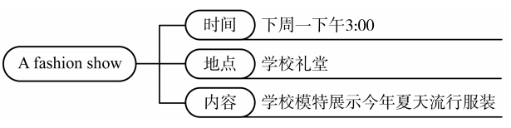
四、书面表达。

Slide 20
四、书面表达。
Dear Susan,
How are you doing? I know you are very interested in clothing.
I have a piece of good news to tell you. There will be a fashion show in our school hall next Monday. It will start at 3:00 p.m. The models from our school will be there to model this summer’s popular clothes. I think the fashion show will be wonderful and

Slide 21
四、书面表达。
and we can learn something about the art of dressing from it. Would you like to go with me? I’m looking forward to hearing from you.
Best wishes.
Yours,
Li Na

Slide 22
